Slide 1
Expert Labs Tech Fest October 2022
AMAUT34_Tech Fest - MQ Statistics, What is available. How do you access them
Bobbee Broderick
rkbroder@us.ibm.com

Slide 2
AMAUT34_Tech Fest - MQ Statistics AUT34_Tech Fest - MQ Statistics
Important Disclaimer
THE INFORMATION CONTAINED IN THIS PRESENTATION IS PROVIDED FOR INFORMATIONAL PURPOSES ONLY.
WHILE EFFORTS WERE MADE TO VERIFY THE COMPLETENESS AND ACCURACY OF THE INFORMATION CONTAINED IN THIS PRESENTATION, IT IS PROVIDED “AS IS”, WITHOUT WARRANTY OF ANY KIND, EXPRESS OR IMPLIED.
IN ADDITION, THIS INFORMATION IS BASED ON IBM’S CURRENT PRODUCT PLANS AND STRATEGY, WHICH ARE SUBJECT TO CHANGE BY IBM WITHOUT NOTICE.
IBM SHALL NOT BE RESPONSIBLE FOR ANY DAMAGES ARISING OUT OF THE USE OF, OR OTHERWISE RELATED TO, THIS PRESENTATION OR ANY OTHER DOCUMENTATION.
NOTHING CONTAINED IN THIS PRESENTATION IS INTENDED TO, OR SHALL HAVE THE EFFECT OF:
CREATING ANY WARRANTY OR REPRESENTATION FROM IBM (OR ITS AFFILIATES OR ITS OR THEIR SUPPLIERS AND/OR LICENSORS); OR
ALTERING THE TERMS AND CONDITIONS OF THE APPLICABLE LICENSE AGREEMENT GOVERNING THE USE OF IBM SOFTWARE.
Information regarding potential future products is intended to outline our general product direction and it should not be relied on in making a purchasing decision. The information mentioned regarding potential future products is not a commitment, promise, or legal obligation to deliver any material, code or functionality. Information about potential future products may not be incorporated into any contract. The development, release, and timing of any future features or functionality described for our products remains at our sole discretion.

Slide 3
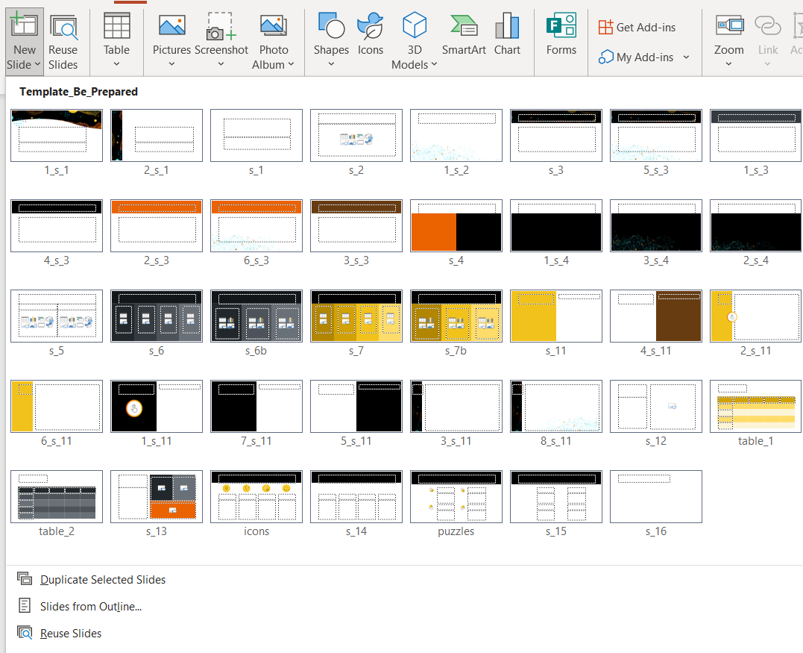
AMAUT34_Tech Fest - MQ Statistics AUT34_Tech Fest - MQ Statistics
In New Slide Options, choose between different content slides:

Slide 4
AMAUT34_Tech Fest - MQ Statistics AUT34_Tech Fest - MQ Statistics
Agenda:
Online Status commands
MQExplorer
AMQSRUA
Event Messages
Queue
Manager
MQConsole
(Monitor MQAppliance)
Offline
Account and Statistics

Slide 5
AMAUT34_Tech Fest - MQ Statistics AUT34_Tech Fest - MQ Statistics
On-line status commands
Available via
MQSC commands
Programmable Command Format (PCF)
MQ Explorer GUI
Queue Manager
Resources
Queues
Channels
Topics
Applications
Connections
Handles
Subscriptions

Slide 6
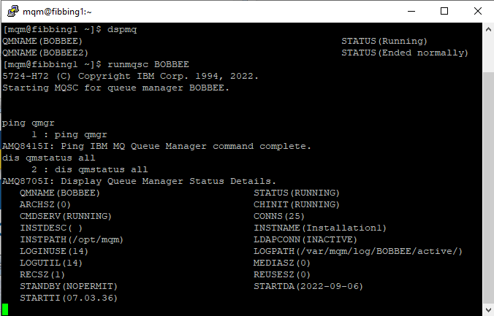
AMAUT34_Tech Fest - MQ Statistics AUT34_Tech Fest - MQ Statistics
Queue Manager Status Commands
“Is the queue manager alive” ?
Control Command
dspmq
MQSC Commands
ping qmgr
Test if QMGR is responsive to commands
Display qmstatus all
Run-time state of the QMGR

Slide 7
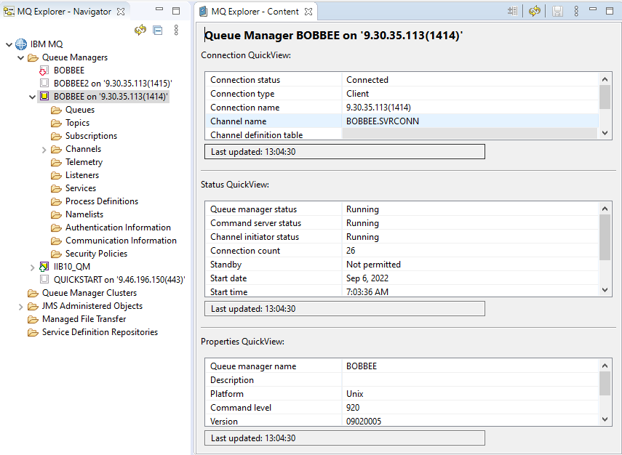
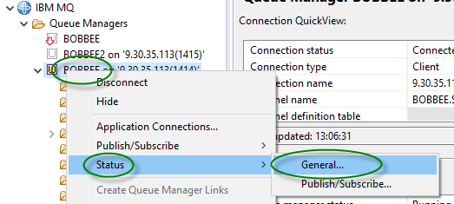
AMAUT34_Tech Fest - MQ Statistics AUT34_Tech Fest - MQ Statistics
Queue Manager Status MQExplorer

Slide 8
AMAUT34_Tech Fest - MQ Statistics AUT34_Tech Fest - MQ Statistics
Queue Status
DISPLAY QSTATUS TYPE(QUEUE) command
Last message Put/Get date and time
Age of oldest message on queue in seconds
DIS QSTATUS(BOBBEE_IN) TYPE(QUEUE)
3 : DIS QSTATUS(BOBBEE_IN) TYPE(QUEUE)
AMQ8450I: Display queue status details.
QUEUE(BOBBEE_IN) TYPE(QUEUE)
CURDEPTH(12) CURFSIZE(1)
CURMAXFS(2088960) IPPROCS(0)
LGETDATE( ) LGETTIME( )
LPUTDATE(2022-10-04) LPUTTIME(11.15.56)
MEDIALOG( ) MONQ(MEDIUM)
MSGAGE(135) OPPROCS(0)
QTIME( , ) UNCOM(NO)

Slide 9
AMAUT34_Tech Fest - MQ Statistics AUT34_Tech Fest - MQ Statistics
DISPLAY QSTATUS TYPE(HANDLE) command
Handles currently open against a queue
DIS QSTATUS(BOBBEE_IN) TYPE(HANDLE)
16 : DIS QSTATUS(BOBBEE_IN) TYPE(HANDLE)
AMQ8450I: Display queue status details.
QUEUE(BOBBEE_IN) TYPE(HANDLE)
APPLDESC( ) APPLTAG(amqsput)
APPLTYPE(USER) BROWSE(NO)
CHANNEL( ) CONNAME( )
ASTATE(NONE) HSTATE(INACTIVE)
INPUT(NO) INQUIRE(NO)
OUTPUT(YES) PID(12885)
QMURID(0.0) SET(NO)
TID(1)
URID(XA_FORMATID[] XA_GTRID[] XA_BQUAL[])
URTYPE(QMGR) USERID(mqm)

Slide 10
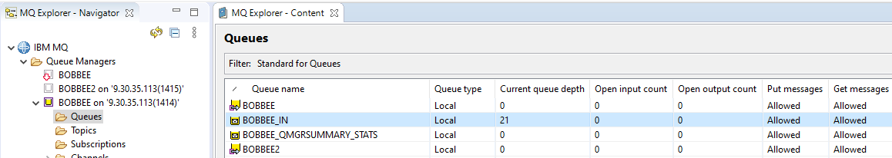
AMAUT34_Tech Fest - MQ Statistics AUT34_Tech Fest - MQ Statistics
DISPLAY QSTATUS MQExplorer
Run-time information about queues

Slide 11
AMAUT34_Tech Fest - MQ Statistics AUT34_Tech Fest - MQ Statistics
CHANNEL STATUS
DIS CHS(BOBBEE.TO.BOBBEE2) ALL
1 : DIS CHS(BOBBEE.TO.BOBBEE2) ALL
AMQ8417I: Display Channel Status details.
CHANNEL(BOBBEE.TO.BOBBEE2) CHLTYPE(SDR)
BATCHES(5) BATCHSZ(50)
BUFSRCVD(6) BUFSSENT(11)
BYTSRCVD(408) BYTSSENT(2813)
CHSTADA(2022-10-04) CHSTATI(11.36.06)
COMPHDR(NONE,NONE) COMPMSG(NONE,NONE)
COMPRATE(0,0) COMPTIME(0,0)
CONNAME(9.30.35.113(1415)) CURLUWID(3853176306C92D10)
CURMSGS(0) CURRENT
CURSEQNO(5) EXITTIME(0,0)
HBINT(300) INDOUBT(NO)
JOBNAME(0000333300000001) LOCLADDR(9.30.35.113(54930))
LONGRTS(999999999) LSTLUWID(0000000000000000)
LSTMSGDA(2022-10-04) LSTMSGTI(11.39.32)
LSTSEQNO(0) MCASTAT(RUNNING)
MONCHL(MEDIUM) MSGS(5)
NETTIME(0,0) NPMSPEED(FAST)
RQMNAME(BOBBEE2) SHORTRTS(10)
SECPROT(NONE) SSLCERTI( )
SSLCIPH( ) SSLKEYDA( )
SSLKEYTI( ) SSLPEER( )
SSLRKEYS(0) STATUS(RUNNING)
STOPREQ(NO) SUBSTATE(MQGET)
XBATCHSZ(1,1) XMITQ(BOBBEE2)
XQTIME(0,0) RVERSION(09020005)
RPRODUCT(MQMM)
DISPLAY CHSTATUS command
Channel Type
Work done

Slide 12
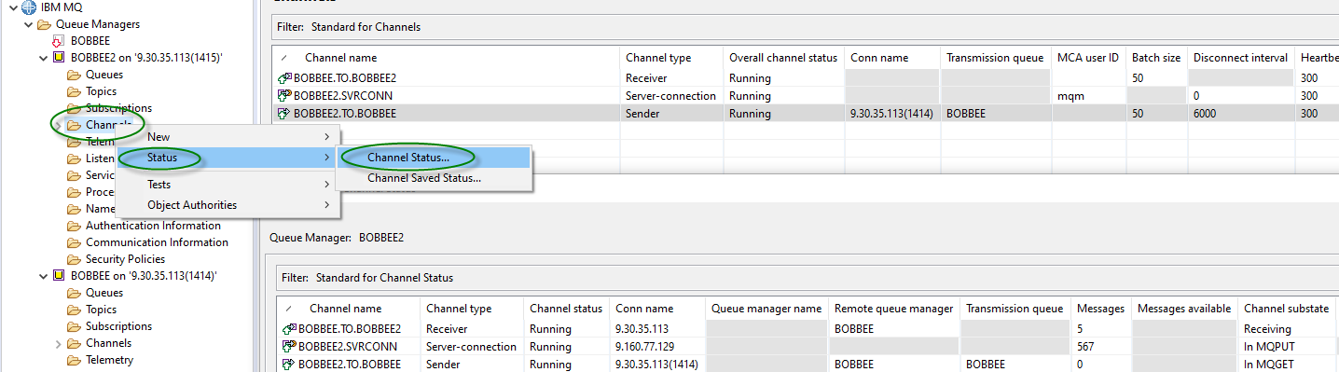
AMAUT34_Tech Fest - MQ Statistics AUT34_Tech Fest - MQ Statistics
DISPLAY CHANNEL STATUS MQExplorer

Slide 13
AMAUT34_Tech Fest - MQ Statistics AUT34_Tech Fest - MQ Statistics
TOPIC/PUBSUB STATUS
DISPLAY TPSSTATUS TYPE(TOPIC) command
Resolution of hierarchically inherited attributes
DIS TPSTATUS('/AUTO/TRUCK/FORD/F250') type(TOPIC) ALL
1 : DIS TPSTATUS('/AUTO/TRUCK/FORD/F250') type(TOPIC) ALL
AMQ8754I: Display topic status details.
TOPICSTR(/AUTO/TRUCK/FORD/F250) ADMIN(MYTOPIC)
CLUSTER( )
COMMINFO(SYSTEM.DEFAULT.COMMINFO.MULTICAST)
MDURMDL(SYSTEM.DURABLE.MODEL.QUEUE)
MNDURMDL(SYSTEM.NDURABLE.MODEL.QUEUE)
CLROUTE(NONE) DEFPSIST(NO)
DEFPRTY(0) DEFPRESP(SYNC)
DURSUB(YES) PUB(ENABLED)
SUB(ENABLED) PMSGDLV(ALLDUR)
NPMSGDLV(ALLAVAIL) RETAINED(NO)
MCAST(DISABLED) PUBCOUNT(0)
SUBCOUNT(0) PUBSCOPE(ALL)
SUBSCOPE(ALL) USEDLQ(YES)

Slide 14
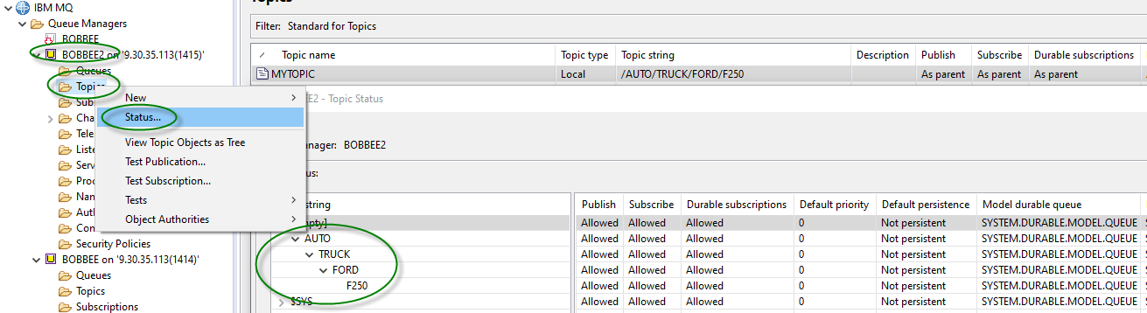
AMAUT34_Tech Fest - MQ Statistics AUT34_Tech Fest - MQ Statistics
DISPLAY TPSSTATUS MQExplorer

Slide 15
AMAUT34_Tech Fest - MQ Statistics AUT34_Tech Fest - MQ Statistics
Status of Applications
Application connections
What applications are active ?
Who is running the applications ?
Whether there any long running Units of Work (UOWs) outstanding ?
Application resources
Open queues, topics or subscriptions
Subscription definitions
Subscription owner/type

Slide 16
AMAUT34_Tech Fest - MQ Statistics AUT34_Tech Fest - MQ Statistics
Status of Applications – DISPLAY CONN cmd
User Application
DIS CONN(*) where(appltype eq user) type(all) all
1 : DIS CONN(*) where(appltype eq user) type(all) all
AMQ8276I: Display Connection details.
CONN(3853176301D06025)
EXTCONN(414D5143424F42424545202020202020)
TYPE(*)
PID(13225) TID(1)
APPLDESC( ) APPLTAG(amqsput)
APPLTYPE(USER) ASTATE(NONE)
CHANNEL( ) CLIENTID( )
CONNAME( ) CONNOPTS(MQCNO_SHARED_BINDING)
USERID(mqm) UOWLOG( )
UOWSTDA( ) UOWSTTI( )
UOWLOGDA( ) UOWLOGTI( )
URTYPE(QMGR)
EXTURID(XA_FORMATID[] XA_GTRID[] XA_BQUAL[])
QMURID(0.0) UOWSTATE(NONE)
CONNTAG(MQCT3853176301D06025BOBBEE_2022-04-06_08.54.20amqsput)
OBJNAME(BOBBEE_IN) OBJTYPE(QUEUE)
ASTATE(NONE) HSTATE(INACTIVE)
OPENOPTS(MQOO_OUTPUT,MQOO_FAIL_IF_QUIESCING)
READA(NO)
Application
User running Application
UOW Ststus
Application Resource

Slide 17
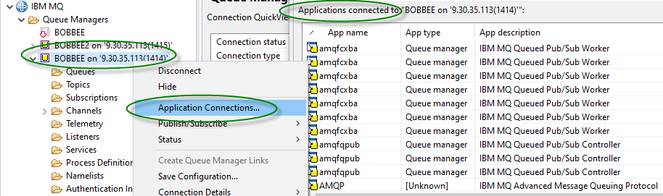
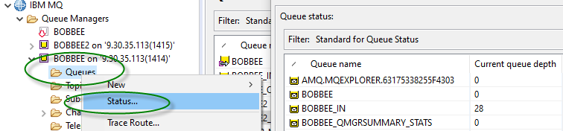
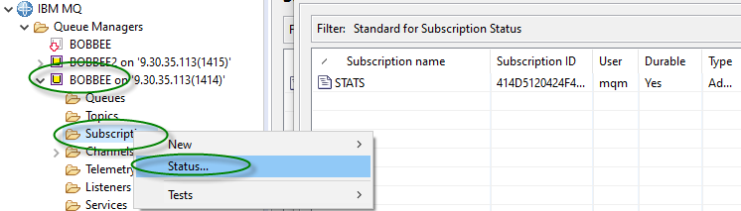
AMAUT34_Tech Fest - MQ Statistics AUT34_Tech Fest - MQ Statistics
MQExplorer
Status of Applications
Open Queues
Subscriptions

Slide 18
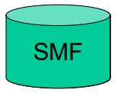

AMAUT34_Tech Fest - MQ Statistics AUT34_Tech Fest - MQ Statistics
STATISTICS AND ACCOUNTING
Accounting and Statistics – Platform differences
Statistics: Data about resource usage and activity within the QMGR
Accounting: Information about what tasks have been doing
z/OS
Written as SMF records
Type 115 and 116
Distributed
Written as PCF format messages
On specific queues
SYSTEM.ADMIN.*.QUEUE

Slide 19
AMAUT34_Tech Fest - MQ Statistics AUT34_Tech Fest - MQ Statistics
Statistics Records TYPE 115 (z/OS)
SMF 115 Subtype 1
System information, for example, related to the logs and storage
Class 1
SMF 115 Subtype 2
Information about number of messages, buffer and paging information
Queue-sharing group information related to the coupling facility and DB2
Class 2
SMF 115 Subtype 3
More detailed information about storage usage in the MSTR address space
Class 2 and 3
SMF 115 Subtype 215
Bufferpool information when the queue manager is running in OPMODE=(NEWFUNC,800) mode.
Class 1
SMF 115 Subtype 231
System information for the CHIN address space.
Class 4

Slide 20
AMAUT34_Tech Fest - MQ Statistics AUT34_Tech Fest - MQ Statistics
Accounting Records TYPE 116 (z/OS)
SMF 116 subtype 0
Message manager records
Class 1
SMF 116 subtype 1 & 2
Data for each task, at thread and queue level.
Class 3
SMF 116 subtype 10
Data for channels
Class 4

Slide 21
AMAUT34_Tech Fest - MQ Statistics AUT34_Tech Fest - MQ Statistics
Statistics Messages (Distributed)
Collects information about IBM MQ resources
Overall, Per Queue, Per Channel
Queue Manager Attributes
STATINT – Statistics Interval  STATMQI – Overall MQI Statistics
STATQ – Queue Statistics
STATCHL – Channel Statistics
STATACLS – Auto-defined Cluster Sender Channel Statistics
Queue Attribute
STATQ – Queue Statistics
Channel Attribute
STATCHL – Channel Statistics
PCF Header fields
MQCMD_STATISTICS_MQI – overall information
MQCMD_STATISTICS_Q – per queue
MQCMD_STATISTICS_CHANNEL – per channel
SYSTEM.ADMIN.STATISTICS.QUEUE
ALTER QMGR STATINT(1800)
STATMQI(ON)
STATQ(ON)
STATCHL(HIGH)
STATACLS(QMGR)
ALTER QLOCAL(q-name)
STATQ(QMGR)
ALTER CHL(chl-name)
CHLTYPE(SDR)
STATCHL(QMGR)

Slide 22
AMAUT34_Tech Fest - MQ Statistics AUT34_Tech Fest - MQ Statistics
Accounting Messages (Distributed)
Collects information about applications which connect to the Queue Manager
Overall
Per Queue
Queue Manager Attribute
ACCTINT – Accounting Interval
ACCTMQI – Overall MQI Accounting
ACCTQ – Queue Accounting
Queue Attribute
ACCTQ – Queue Accounting
PCF Header fields
MQCMD_ACCOUNTING_MQI – overall information
MQCMD_ACCOUNTING_Q – per Queue
SYSTEM.ADMIN.ACCOUNTING.QUEUE
ALTER QMGR
ACCTINT(1800)
ACCTMQI(ON)
ACCTQ(ON)
ALTER QLOCAL(q-name)
ACCTQ(QMGR)

Slide 23
AMAUT34_Tech Fest - MQ Statistics AUT34_Tech Fest - MQ Statistics
What can I discover ?
Open details
First open time, last close time for a queue
MQCMD_ACCOUNTING_Q message on Distributed
MQGET details
Count, total bytes, msg-size (min / max), time-on-queue (min / avg / max) (persistent / non-persistent) for a queue
MQCMD_ACCOUNTING_Q message on Distributed
API counts
For each of the MQ API's (MQPUT / MQGET/ ...) across the queue manager
MQCMD_STATISTICS_MQI on Distributed
Number of messages transferred (persistent / non-persistent) on a channel
MQCMD_STATISTICS_CHANNEL on Distributed
Batch Info (total / number full / avg size) on a channel
MQCMD_STATISTICS_CHANNEL on Distributed

Slide 24
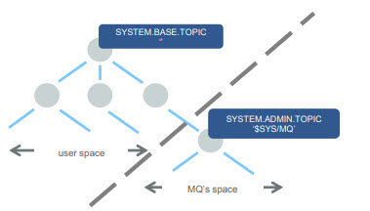
AMAUT34_Tech Fest - MQ Statistics AUT34_Tech Fest - MQ Statistics
System topics – new for MQ V9
IBM MQ V9 (and the M2000 Appliance) has created its own branch of the topic tree
“$SYS/MQ”
This is used for publishing and subscribing to data from the queue manager
A new default object sits at the root of this branch, SYSTEM.ADMIN.TOPIC
It sits below SYSTEM.BASE.TOPIC but consider it a completely new tree
No attributes are inherited from above
No authorities are inherited from above
The topic nodes are not matched by wildcards above it
E.g. Subscribing to ‘#’ will not match anything starting “$SYS/MQ”
Out of the box, access to the branch is restricted to administrators only
Access can be granted to other users through the definition of admin topics and access control at key points below $SYS/MQ

Slide 25
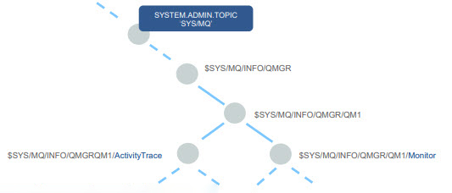
AMAUT34_Tech Fest - MQ Statistics AUT34_Tech Fest - MQ Statistics
New system topic publications
MQ V9 publishes two types to data under the system topic branch
Application activity trace
Resource monitoring
Each queue manager listens for subscriptions to recognized topic strings and only publishes when subscriptions exist

Slide 26
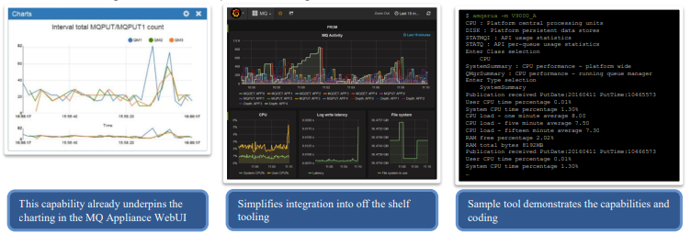
AMAUT34_Tech Fest - MQ Statistics AUT34_Tech Fest - MQ Statistics
Subscribe to MQ and system monitoring information
Subscribe for a regular feed of performance monitoring information
Familiar queue manager wide and queue level statistics
Plus new CPU, memory and disk usage
For example, disk reads/writes, disk latency
Enables integration into multiple monitoring solutions

Slide 27
AMAUT34_Tech Fest - MQ Statistics AUT34_Tech Fest - MQ Statistics
AMQSRUA System stat Sample program
Sample program installed with ‘Tools’
Command line execution
Subscribes to System Stat Topics
Digests and transforms PCF to readable statistics
Can be run in DEBUG mod to provide Meta Topic Data
CLASS name. IBM MQ resource usage publications are associated with a class. The classes represent the top level in the tree of metadata that describes the available resource usage information.
CPU
Returns information about CPU usage.
DISK
Returns information about disk usage.
STATMQI
Returns information about MQI usage.
STATQ
Returns information about per-queue MQI usage.

Slide 28
AMAUT34_Tech Fest - MQ Statistics AUT34_Tech Fest - MQ Statistics
Programmable command formats (PCFs) reference
PCFs define command and reply messages that can be exchanged across a network between a program
Interacts with target Queue Manager
PCF Commands for most MQSC commands
PCF Command Reference
Introduction to IBM MQ Programmable Command Formats
Commonly used in Python and JAVA
Sample PYTHON scripts

Slide 29
AMAUT34_Tech Fest - MQ Statistics AUT34_Tech Fest - MQ Statistics
DEMO
DEMO of Python scripts
System Statistics – Collect system statistics, i.e. CPU, memory file system usage by QMGR
Queue Statistics – Collect queue statistics using INQ_QUEUE, INQ_QUEUE_STATS and RESET_QSTATS commands via PYMQI and uses ‘amqsrua’ to collect further information about the queue GET and PUT statistics
Channel Statistics - Collect channel statistics using INQ_CHANNEL, INQ_CHANNEL_STATS commands via PYMQI
Scripts connect to a Queue Manager and issue PCF Commands against the queue manager. The scripts also execute the ‘amqsrua’ sample program for a single instance of a multi faceted request and then parses the result for specific values.
The scripts produce a CSV output with a header line as the first line. The scripts are written to collect all the statistics for each one to a monthly report file which can be imported into EXCEL for further processing.

Slide 30

AMAUT34_Tech Fest - MQ Statistics AUT34_Tech Fest - MQ Statistics
Links and Winks
GITHUB Script samples – Scripts and Client QMGR Connect code used in this DEMO
MS0P Support Pack – The Extended Management plug-ins for the IBM WebSphere MQ Explorer extend the capabilities for queue manager configuration, and display additional information about the queue managers
IBM MQ and Open-Source Monitoring – Technical Conference presentation on monitoring
MP1B: z/OS - Interpreting acct and stat data - SupportPac contains a program for formatting IBM MQ statistics and accounting SMF records. There are other programs that help you monitor your IBM MQ system on z/OS
Building and Running the IBM mq_prometheus collector on Windows

Slide 31

AMAUT34_Tech Fest - MQ Statistics AUT34_Tech Fest - MQ Statistics

